Slide 1
CSE101-Lec#6-Part-1
Control structures(Decision control statements/ or Condition Statements)

Slide 2
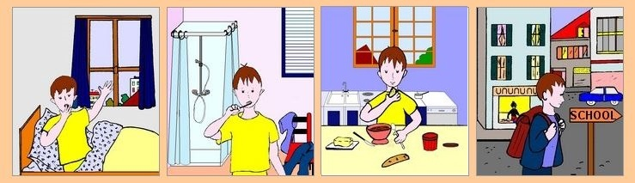

Program
Program is a set of instruction executed one by one.
Depending upon the circumstances sometimes it is desirable to alter the sequence of execution of statements.
1. Wake up;
2. Get ready;
3. If you have enough time, then eat breakfast;
4. Go to school.

Slide 3
Control Statements
The C language programs until now follows a sequential form of execution of statements.
C language provides statements that can alter the flow of a sequence of instructions. These statements are called control statements.
These statements help to jump from one part of the program to another. The control transfer may be conditional or unconditional.

Slide 4
Control Structure
A control structure refers to the way in which the programmer specifies the order of executing the statements.
Three control structures
  Sequence structure
    Programs are executed sequentially by default.
  Selection structures(Condition)
    if, if…else, if-else-if, Nested-if ,switch
  Repetition structures (iteration)
    while, do…while, for
Notes:
Sequence- all statements are executed in the order as it is written
Selection- Different sets of statements are executed based on one or more conditions
Iteration- Certain set of statements are executed repeatedly

Slide 5
Condition Statements(or Decision control statements or Branching statements)
The C condition statements or the decision statements, checks the given condition
Based upon the state of the condition, a sub-block is executed.
Decision statements are the:
  if statement
  if-else statement
  If-else-if statement
  Nested if statement
  switch statement

Slide 6
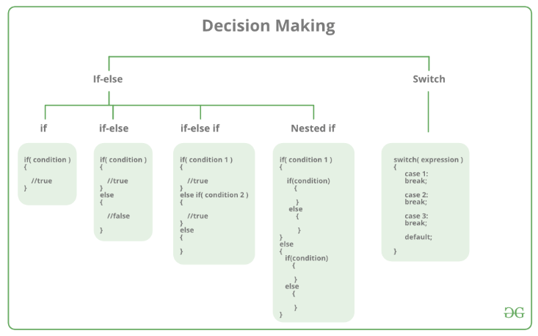

Slide 7


Daily routine
Start
Go!!!
Where
To
Go?
Class
Movie
Stop
Stop

Slide 8
if statement
Yes
If you have time?
No

Slide 9
if Statement
If statement
  It is decision making statement uses keyword if.
  It allows the computer to evaluate the expression first
    and then, depending on whether the value is ‘true’ or ‘false’, i.e. non zero or zero it transfers the control to a particular statement.
A decision can be made on any expression.
zero - false
nonzero - true
Example:
3 < 4 is true

Slide 10
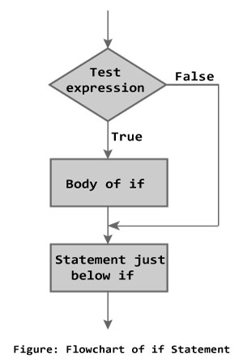
if Statement
Syntax
if (expression)
statement;
or
if (expression)
{
block of statements;
}

Slide 11
if Statement
The if statement has the following syntax:
The condition must be a
boolean expression. It must
Evaluate to either non-zero or zero.
if is a C
reserved word
if ( condition )/* no semi-colon */
statement;
If the condition is non-zero, the statement is executed.
If it is zero, the statement is skipped.

Slide 12


Rain ???
Is it going to rain?
Look up sky for clouds
yes
Clouds?
no
No rain
Raining

Slide 13
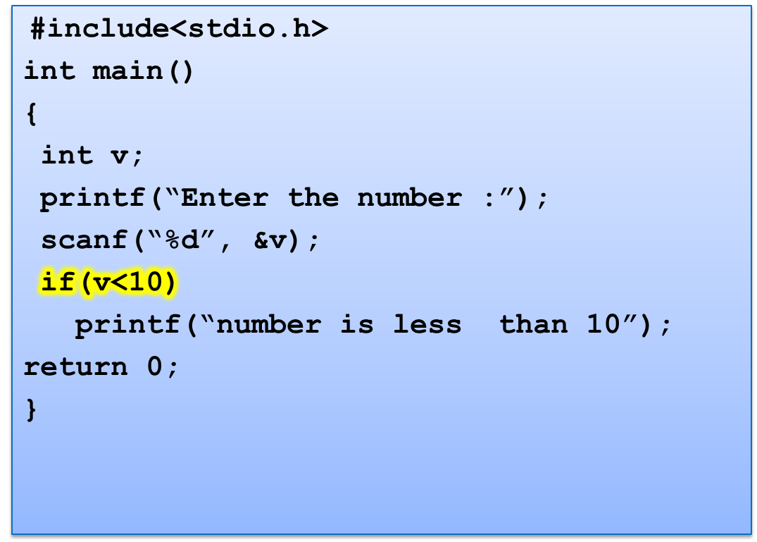
Program to check whether number is less than 10.
Enter the number: 6
Number is less than 10

Slide 14
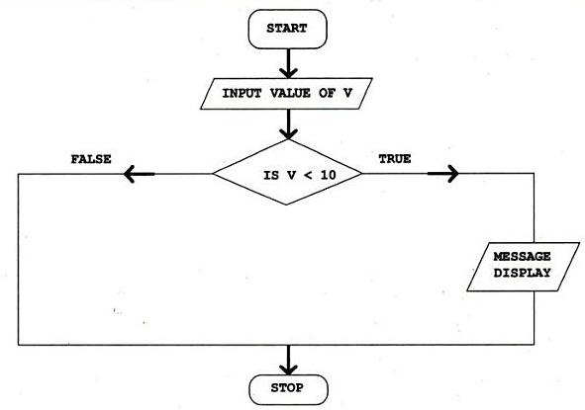
Control Flow

Slide 15
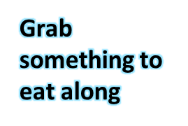

if..else statement
Yes
If you have time?
No

Slide 16
if..else statement
The if statement executes only when the condition following if is true.
It does nothing when the condition is false.
The if..else statement takes care of the true and false conditions.

Slide 17
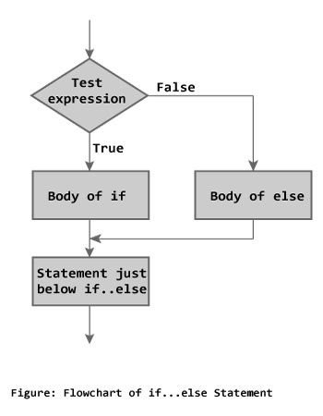
if..else statement
if..else has two blocks.
One block is for if and it is executed when condition is non-zero(true).
The other block is of else and its executed when condition is zero (false).
if (expression)
{
block of statements;
}
else
{
block of statements;
}
Syntax

Slide 18
if..else statement
The else statement cannot be used without if.
No multiple else statements are allowed with one if.
else statement has no expression.
Number of else cannot be greater than number of if.

Slide 19
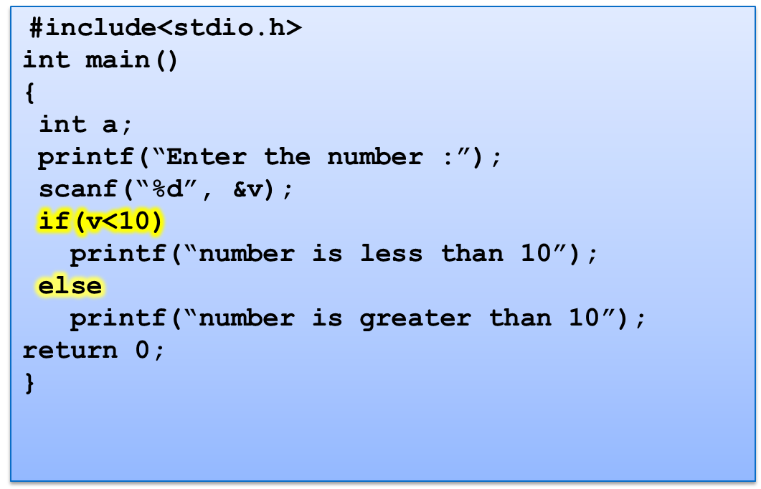
Example : Program to check whether number is less than 10.
Enter the number: 7
Number is less than 10
or
Enter the number: 100
Number is greater than 10

Slide 20
Control Flow
MESSAGE
DISPLAY

Slide 21
Q1
What will be the output of the following C code?
#include <stdio.h>
int main()
{
int x = 5;
if (x < 1)
printf("hello");
if (x == 5)
printf("hi");
else
printf("no");
return 0;
}
A. hi
B. hello
C. no
D. error
Notes:
A

Slide 22
Q2
What will be the output of the following C code?
#include <stdio.h>
int main()
{
int x = 0;
if (x == 0)
printf("hi");
else
printf("how are u");
printf("hello");
return 0;
}
A. hi
B. how are you
C. hello
D. hihello
Notes:
D

Slide 23
Q3
What will be the output of the following C code?
#include <stdio.h>
int main()
{
int x = 5;
if (x < 1);
printf("Hello");
}
A. Nothing will be printed
B. Compile time error
C. Hello
D. Logical error
Notes:
C

Slide 24
Q4
#include<stdio.h>
int main()
{
float x=2.3;
if(x==2.3)
{
printf("Hi");
}
else
{
printf("Hello");
}
return 0;
}
Hi
Hello
Compile time error
None of these
Notes:
B

Slide 25
Q5
#include<stdio.h>
int main()
{
int x=-1;
if(x)
{
printf("Hi");
}
else
{
printf("Hello");
}
return 0;
}
Hi
Hello
Compile time error
None of these
Notes:
A

Slide 26
Q6
What is the output of this C code?
#include <stdio.h>
int main()
{
float f = 0.1;
if (f == 0.1)
printf("True");
else
printf("False");
return 0;
}
A. True
B. False
C. Compile time error
D. None of these
Notes:
B

Slide 27
If-else-if
if-else-if statement is used when program requires more than one test expression.
We can check multiple conditions, and what so ever condition is true, that part will work
Here, a user can decide among multiple options. The C if statements are executed from the top down. As soon as one of the conditions controlling the if is true, the statement associated with that if is executed, and the rest of the C else-if ladder is bypassed. If none of the conditions are true, then the final else statement will be executed.

Slide 28
If-else-if ladder
if ( condition ) {
block of statements;
}
else if ( condition ) {
block of statements; }
else {
block of statements;
}
Syntax

Slide 29
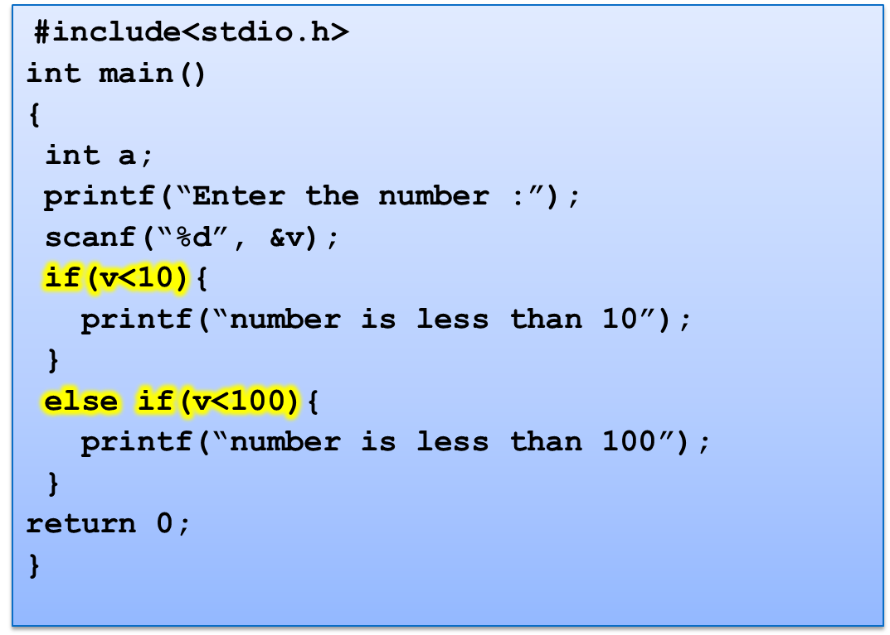
Program to check whether number is less than 10.
Enter the number: 1
Number is less than 10
or
Enter the number: 56
Number is less than 100

Slide 30
Program to print grades of students marks.
#include<stdio.h>
int main()
{
float marks;
scanf(“%f”, &marks);
if (marks>90){
printf(“Grade A”);
}
else if (marks>80) {
printf(“Grade B”);
}
else if(marks>70){
printf(“Grade C”);
}
else if (marks >60) {
printf(“Grade D”);
}
return 0;
}
66.70
Grade D
or
78.00
Grade C

Slide 31
Q1
#include <stdio.h>
int main()
{
int x = 1;
if (x > 0)
printf("inside if\n");
else if (x > 0)
printf("inside elseif\n");
}
A. inside if
B. inside elseif
C. inside if
inside elseif
D. Compile time error

Slide 32
Q2
What will be the output of the following C code?
#include <stdio.h>
int main()
{
int x = 0;
if (x++)
printf("true\n");
else if (x == 1)
printf("false\n");
}
A. true
B. false
C. Compile time error
D. undefined behaviour

Slide 33
Q3
What will be the output of the following C code?
#include <stdio.h>
int main()
{
int x = 0;
if (x == 0)
printf("true, ");
else if (x = 10)
printf("false, ");
printf("%d\n", x);
return 0;
}
A. false, 0
B. true, 0
C. true, 10
D. compile time error

Slide 34
Nested if
A nested if in C is an if statement that is the target of another if statement. Nested if statements means an if statement inside another if statement. C allows us to nested if statements within if statements, i.e, we can place an if statement inside another if statement.

Slide 35
Syntax
if (condition1)
{
// Executes when condition1 is true
if (condition2)
{
// Executes when condition2 is true
}
}

Slide 36
Program example
// C program to illustrate nested-if statement
#include <stdio.h>
int main()
{
int i = 10;
if (i == 10)
{
// First if statement
if (i < 15)
printf("i is smaller than 15\n");
// Nested - if statement
// Will only be executed if statement above is true
if (i < 12)
printf("i is smaller than 12 too\n");
else
printf("i is greater than 15");
}
return 0;
}
Output
i is smaller than 15
i is smaller than 12 too

Slide 37
What will be the output of following code?
#include <stdio.h>
int main()
{
int x = 0;
if (x == 1)
if (x >= 0)
printf("true\n");
else
printf("false\n");
}
A. true
B. false
C. Depends on the compiler
D. Nothing will be printed
Notes:
D

Slide 38
What will be the output of the following C code?
#include <stdio.h>
int main()
{
int x = 0;
if (x == 1)
if (x == 0)
printf("inside if\n");
else
printf("inside else if\n");
else
printf("inside else\n");
return 0;
}
A.inside if
B.inside else if
C.inside else
D.Compile time error
Notes:
C

Slide 39
break statement
break is a keyword.
break allows the programmer to terminate the loop.
A break statement causes control to transfer to the first statement after the loop or block.
The break statement can be used in nested loops. If we use break in the innermost loop then the control of the program is terminated only from the innermost loop.

Slide 40

switch Statement
Day= Monday
Day= Sunday
No
Yes

Slide 41
switch Statement
The control statement that allows to make a decision from the number of choices is called switch.
Also called switch-case-default.
The switch statement provides another way to decide which statement to execute next.
The switch statement evaluates an expression, then attempts to match the result to one of several possible cases.
Each case contains a value and a list of statements.
The flow of control transfers to statement associated with the first case value that matches.

Slide 42
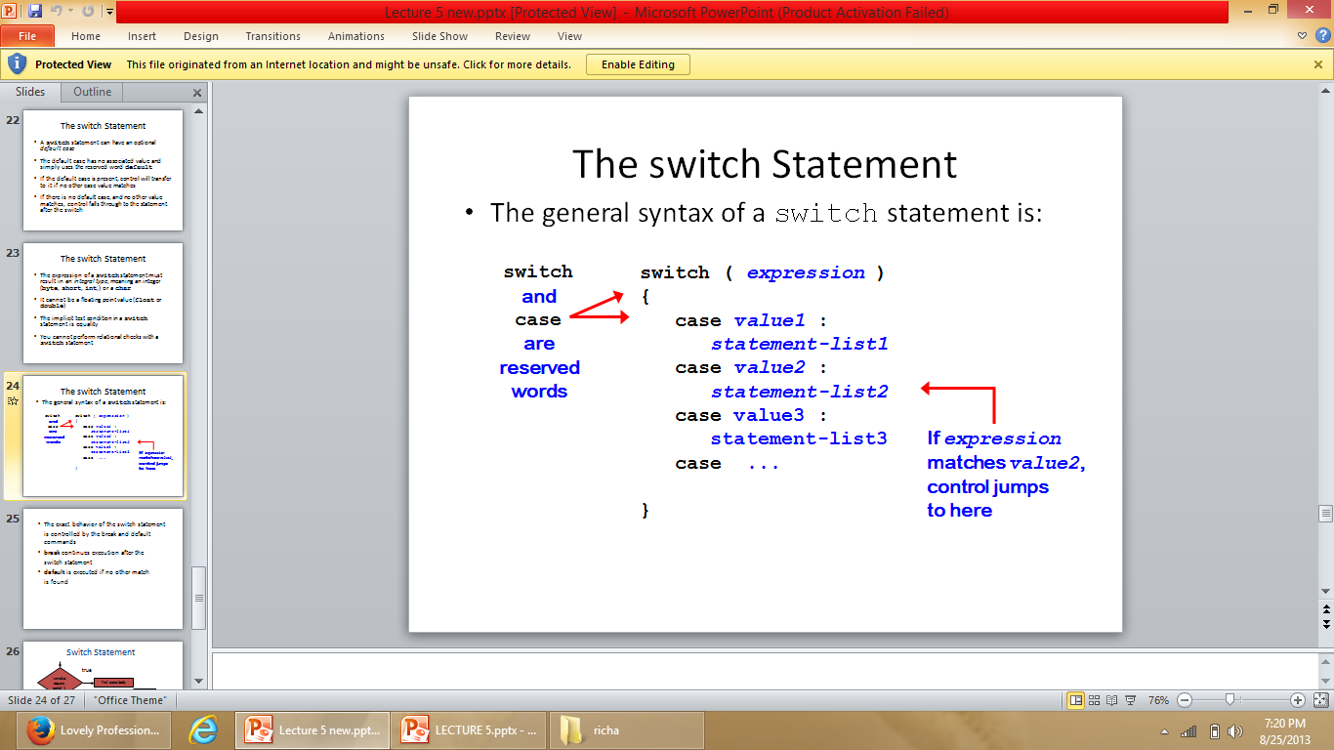
switch Statement
switch (expression)
{
case constant1:
statements;
break;
case constant2:
statements;
break;
case constant3:
statements;
break;
default:
statements;
}
Syntax

Slide 43
Rules of using switch case
Case label must be unique
Case label must end with colon
Case label must have constant expression
Case label must be of integer, character type like case 2, case 1+1, case ‘a’
Case label should not be floating point
Default can be placed anywhere in switch
Multiple cases cannot use same expression
Nesting of switch is allowed.
Variables are not allowed in switch case label..

Slide 44
Syntax error in switch statement
Variable cannot be used as label
switch(pt){
case count:
printf(“%d”, count);
break;
case 2.5:
printf(“A line”);
break;
case 3 + 7.7:
printf(“A triangle”);
case 3 + 7.7:
printf(“A triangle”);
break;
case count+5:
printf(“A pentagon”);
break;
}
Floating point number cannot be used
Floating point number cannot be used and same expression cannot be used
constant expression should be used

Slide 45
#include<stdio.h>
int main()
{
int pt;
printf("Enter the number of nodes:");
scanf("%d", &pt);
switch(pt){
case 0:
printf("\nNo Geometry");
break;
case 1:
printf("\nA point");
break;
case 2:
printf("\nA line");
break;
case 3:
printf("\nA triangle");
break;
case 4:
printf("\nA rectangle");
break;
case 5:
printf("\nA pentagon");
break;
default:
printf("Invalid input");
break;
}
return 0;
}
Program to show switch statement in geometry
Enter the number of nodes: 2
A line

Slide 46
Q1
#include <stdio.h>
int main()
{
double ch;
printf("enter a value between 1 to 2:");
scanf("%lf", &ch);
switch (ch)
{
case 1:
printf("1");
break;
case 2:
printf("2");
break;
}
return 0;
}
A. Compile time error
B. 1
C. 2
D. Nothing will be displayed

Slide 47
Q2
What will be the output of the following C code? (Assuming that we have entered the value 1 in the standard input)
#include <stdio.h>
int main()
{
int ch;
printf("enter a value between 1 to 2:");
scanf("%d", &ch);
switch (ch)
{
case 1:
printf("1 ");
default:
printf("2");
}
return 0;
}
A. 1
B. 2
C. 1 2
D. Compile time error
Notes:
C

Slide 48
Q3
What will be the output of the following C code? (Assuming that we have entered the value 1 in the standard input)
#include <stdio.h>
int main()
{
int ch;
printf("enter a value between 1 to 2:");
scanf("%d", &ch);
switch (ch)
{
case 1:
printf("1 ");
printf("hi");
break;
default:
printf("2\n");
}
}
A. 1 hi
B. 2
C. hi
D. 1

Slide 49
Q4
What will be the output of the following C code?
#include <stdio.h>
int main()
{
int x = 97;
switch (x)
{
case 'a':
printf("yes ");
break;
case 97:
printf("no");
break;
}
}
A. yes
B. yes no
C. Duplicate case value error
D. Nothing will be displayed

Slide 50
Q5
What will be the output of the following C code?
#include <stdio.h>
int main()
{
int a = 1;
switch (a)
{
case a:
printf("Case A ");
default:
printf("Default");
}
return 0;
}
A. Output: Case A
B. Output: Default
C. Output: Case A Default
D. Compile time error

